Slide 1
Transfer Learning in CNN
Presented by
M . Mohana
Research Scholar

Slide 2
Transfer Learning
Transfer learning is the improvement of learning in a new task through the transfer of knowledge from a related task that has already been learned.
Know how to ride a motorbike → Learn how to ride a car.
Know math and statistics → Learn machine learning.
Transfer Learning is not a concept.

Slide 3
Neural networks are initialized with random weights (usually) that after a series of epochs reach some values that allow us to properly classify our input images.
What would happen if we could initialize those weights to certain values that know beforehand that are already good to classify a certain dataset?
In this way, would not need a dataset as big as if were to train a network from zero (from hundreds of thousands or even millions of images we could go to a few thousands) nor would need to wait a good number of epochs for the weights to take good values for the classification, they would have it much easier due to their initialization.

Slide 4
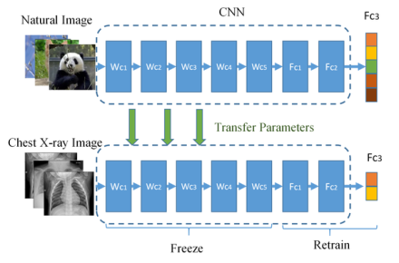

Slide 5

Typical CNN
Convolutional base/Feature learning(Conv+Relu+Pooling)
Classifier/Classification(Fully connected layer)

Slide 6
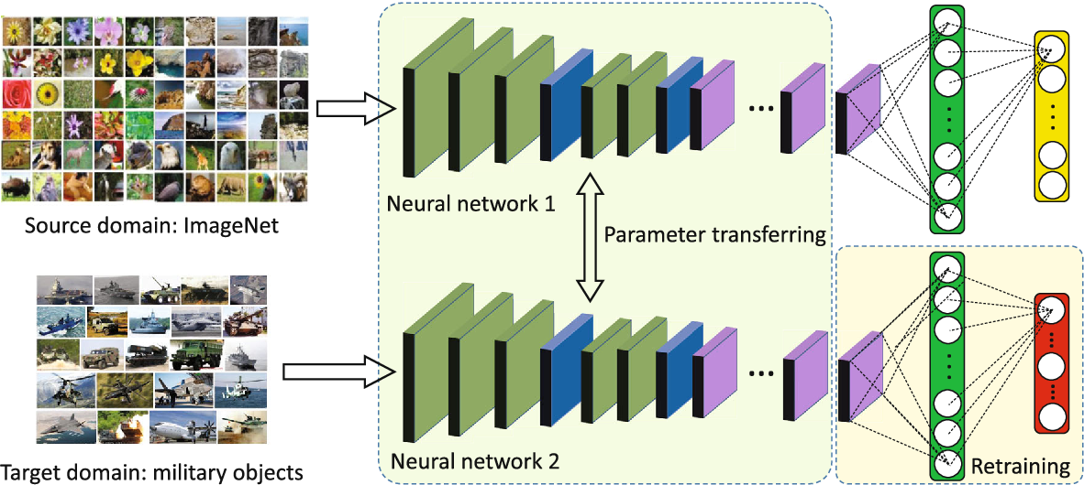
Transfer learning
ConvNet as a fixed feature extractor/train as classifier.
Finetuning the ConvNet/fine tune.
Pretrained models.

Slide 7
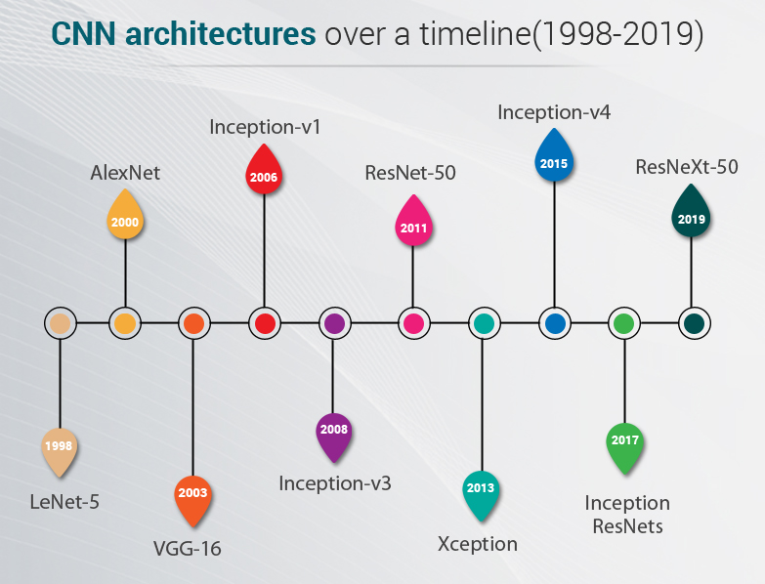
Transfer learning

Slide 8
ImageNET
ImageNet is a large database or dataset of over 14 million images.
It was designed by academics intended for computer vision research.
ImageNet consists of a dataset of about 1.2 million images for training, 50,000 for validation and 100,000 for testing, belonging to 1000 categories.
In Machine Learning and Deep Neural Networks, machines are trained on a vast dataset of various images.
Machines are required to learn useful features from these training images.

Slide 9
Keras Application
Model | Size | Top-1 Accuracy | Top-5 Accuracy | Parameters (Weights)
Xception | 88 MB | 0.790 | 0.945 | 22,910,480
VGG16 | 528 MB | 0.713 | 0.901 | 138,357,544
VGG19 | 549 MB | 0.713 | 0.900 | 143,667,240
ResNet50 | 98 MB | 0.749 | 0.921 | 25,636,712
ResNet101 | 171 MB | 0.764 | 0.928 | 44,707,176
ResNet152 | 232 MB | 0.766 | 0.931 | 60,419,944
ResNet50V2 | 98 MB | 0.760 | 0.930 | 25,613,800
ResNet101V2 | 171 MB | 0.772 | 0.938 | 44,675,560
ResNet152V2 | 232 MB | 0.780 | 0.942 | 60,380,648

Slide 10
InceptionV3 | 92 MB | 0.779 | 0.937 | 23,851,784
InceptionResNetV2 | 215 MB | 0.803 | 0.953 | 55,873,736
MobileNet | 16 MB | 0.704 | 0.895 | 4,253,864
MobileNetV2 | 14 MB | 0.713 | 0.901 | 3,538,984
DenseNet121 | 33 MB | 0.750 | 0.923 | 8,062,504
DenseNet169 | 57 MB | 0.762 | 0.932 | 14,307,880
DenseNet201 | 80 MB | 0.773 | 0.936 | 20,242,984
NASNetMobile | 23 MB | 0.744 | 0.919 | 5,326,716
NASNetLarge | 343 MB | 0.825 | 0.960 | 88,949,818

Slide 11
Top-1 & Top-5 accuracy
Top-1 accuracy is the conventional accuracy, which means that the model answer (the one with the highest probability) must be exactly the expected answer.
Top-5 accuracy means that any of your model that gives 5 highest probability answers that must match the expected answer.
A machine learning algorithm for object recognition using a neural network. A picture of a cat is shown, and these are the outputs of your neural network:
Tiger: 0.4
Dog: 0.3
Cat: 0.1
Lynx: 0.09
Lion: 0.08
Bird: 0.02
Bear: 0.01
In the above-mentioned probabilities:
Using top-1 accuracy, you will count this output as wrong, because it predicted a tiger.
Using top-5 accuracy, you count this output as correct, because the cat is among the top-5 guesses.

Slide 12
Vanishing Gradient problem
This involves first calculating the prediction error made by the model and using the error to estimate a gradient used to update each weight in the network so that less error is made next time. This error gradient is propagated backward through the network from the output layer to the input layer.
Vanishing gradients make it difficult to know which direction the parameters should move to improve the cost function.
In fact, the error gradient can be unstable in deep neural networks and not only vanish, but also explode, where the gradient exponentially increases as it is propagated backward through the network. This is referred to as the “exploding gradient” problem.

Slide 13
The weights of a neural network are updated using the backpropagation algorithm. The backpropagation algorithm makes a small change to each weight in such a way that the loss of the model decreases. How does this happen? It updates each weight such that it takes a step in the direction along which the loss decreases.
Using chain rule we can find this gradient for each weight.
As this gradient keeps flowing backward to the initial layers, this value keeps getting multiplied by each local gradient. Hence, the gradient becomes smaller and smaller, making the updates to the initial layers very small, increasing the training time considerably.

Slide 14
LeNET-5
Architecture: LeNet-5 has 2 convolutional and 3 fully connected layers. It has trainable weights and a sub-sampling layer (now known as the pooling layer). LeNet5 has about 60,000 parameters.
Year of Release: 1998
About: Developed by Yann LeCunn as he applied a backdrop style to Fukushima’s convolutional neural network architecture.
USP: Neural network architecture for handwritten and machine-printed character recognition in 1990’s which they called LeNet-5. The architecture is straightforward and simple to understand that’s why it is mostly used as a first step for teaching Convolutional Neural Network.

Slide 15
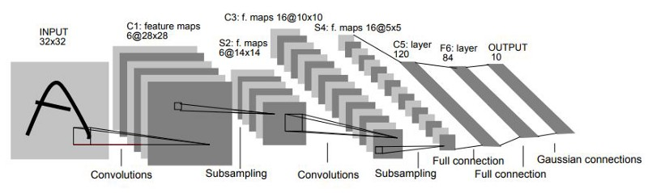
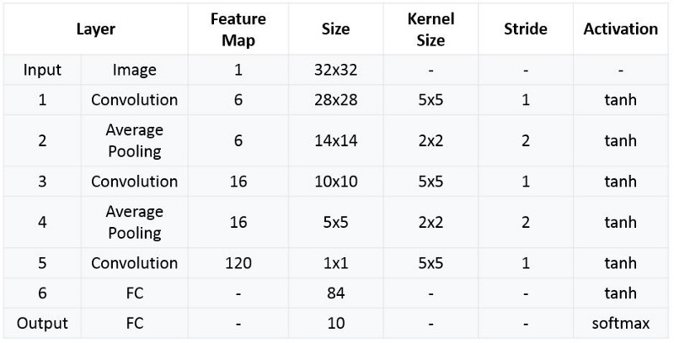

Slide 16
AlexNet
AlexNet architecture consists of 5 convolutional layers, 3 max-pooling layers, 2 normalization layers, 2 fully connected layers, and 1 softmax layer.
Each convolutional layer consists of convolutional filters and a nonlinear activation function ReLU.
The pooling layers are used to perform max pooling.
Input size is fixed due to the presence of fully connected layers.
The input size is mentioned at most of the places as 224x224x3 but due to some padding which happens it works out to be 227x227x3
AlexNet overall has 60 million parameters.

Slide 17
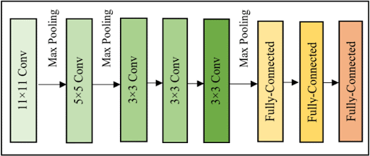
AlexNet

Slide 18
VGG (Visual Geometry Group)
Why? VGGNet was born out of the need to reduce the No of parameters in the CONV layers and improve on training time.
What? There are multiple variants of VGGNet (VGG16, VGG19, etc.) which differ only in the total number of layers in the network.
Unfortunately, there are two major drawbacks with VGGNet:
It is painfully slow to train.
The network architecture weights themselves are quite large (in terms of disk/bandwidth).

Slide 19
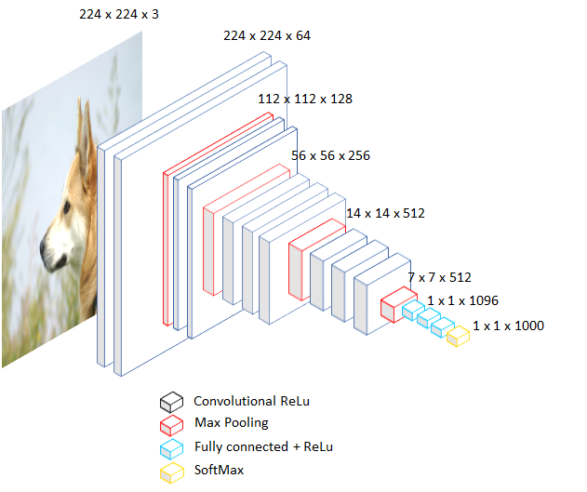
VGG-16

Slide 20
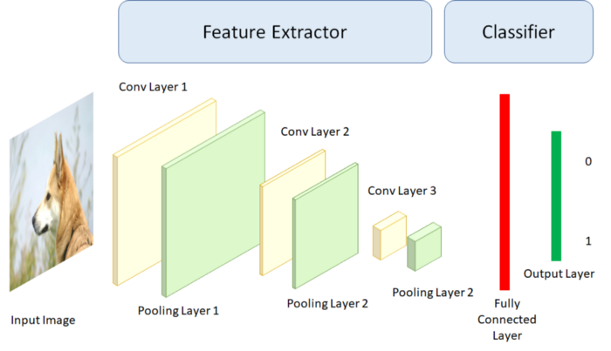
Pure CNN

Slide 21
What if we removed the last layer of the VGG16, which simply takes a probability for each of the 1000 classes in the ImageNet and replaces it with a layer that takes 10 probabilities?
Do is change the classification stage, so that the last layer is one of 10 neurons (our CIFAR 10 has 10 classes) and then will retrain the network allowing the weights of the fully connected layers to be changed, that is, the classification stage.
For this, to initialize our network with the weights from the ImageNet, and then freeze all the convolutional and max-pooling layers so that they do not modify their weights, leaving only the fully connected ones free.

Slide 22
Once this is done, we would start retraining. In this way, manage to take advantage of the feature extraction stage of our network and only tune the final classifier to work better with our dataset. This is what is known as Transfer Learning because take advantage of the knowledge of another problem to solve the one we are dealing with.
This approach can also be done by saving the characteristics given by the last layer of max pooling and then putting that data into any classifier (SVM, SVM, Logistic Regression, Random Forest, decision trees, etc).

Slide 23
GoogLeNet / Inception
The Inception network was an important milestone in the development of CNN classifiers.
The popular versions are as follows:
Inception v1
Inception v2
Inception v3
Inception v4
Inception-ResNet
Each version is an iterative improvement over the previous one.

Slide 24
Inception-v1
Architecture: Inception-v1 heavily used the Network in Network approach and had 22 layers along with 5 million parameters.
Year of Release: 2014
About: This network was a result of a study on approximating sparse architectures. The strongest feature of this network was the improved usage of computer resources inside the neural network.
USP: Instead of stacking convolutional layers a top each other, this network stacked dense modules which had convolutional layers within them.

Slide 25
Inception-v3
Architecture: A successor to Inception-v1, Inception v-3 had 24 million parameters and ran 48 layers deep.
Year of Release: 2015
About: Inception v3 could classify images into a total of 1000 categories, including keyboard, pencil, mouse, and many other animals. This model was trained on more than one million images from the ImageNet database.
USP: Inception v3 was among the first algorithms to use batch normalization. It also used the factorization method to have more efficient computations.

Slide 26
Inception-v4
Architecture: With 43 million parameters and an upgraded Stem module, Inception-v4 is touted to have a dramatically improved training speed due to residual connections.
Year of Release: 2016
About: Developed by Google researcher, Inception v4 had undergone uniform choices for each grid size.
USP: deeper network, Stem improvements, and the same number of filters in every convolution block.

Slide 27
ResNet
ResNet, short for Residual Network is a specific type of neural network.
Why? Neural Networks are notorious for not being able to find a simpler mapping when it exists.
Another example is adding more layers to an existing neural network. In a network f(x) that has achieved an accuracy of n% on a data-set. Now adding more layers to this network g(f(x)) should have at least an accuracy of n% i.e. in the worst case g(.) should be an identical mapping yielding the same accuracy as that of f(x) if not more.
But unfortunately, that is not the case. Experiments have shown that the accuracy decreases by adding more layers to the network.

Slide 28
Architecture: consisting of 50 layers of ResNet blocks (each block having 2 or 3 convolutional layers), ResNet 50 had 26 million parameters.
Year of Release: 2015
About: The basic building blocks for ResNet-50 are convolutional and identity blocks. To address the degradation in accuracy, Microsoft researchers added skip connection ability.
USP: ResNet-50 popularized skip connection and provided a way for developers to build even deeper CNNs without compromising accuracy. Also, ResNet-50 was among the first CNNs to have the batch normalization feature.

Slide 29
ResNET
What? There are multiple versions of ResNetXX architectures where ‘XX’ denotes the number of layers. The most commonly used ones are ResNet50 and ResNet101. Since the vanishing gradient problem was taken care of, CNN started to get deeper and deeper.
How? ResNet architecture makes use of shortcut connections to solve the vanishing gradient problem. The basic building block of ResNet is a Residual block that is repeated throughout the network.

Slide 30
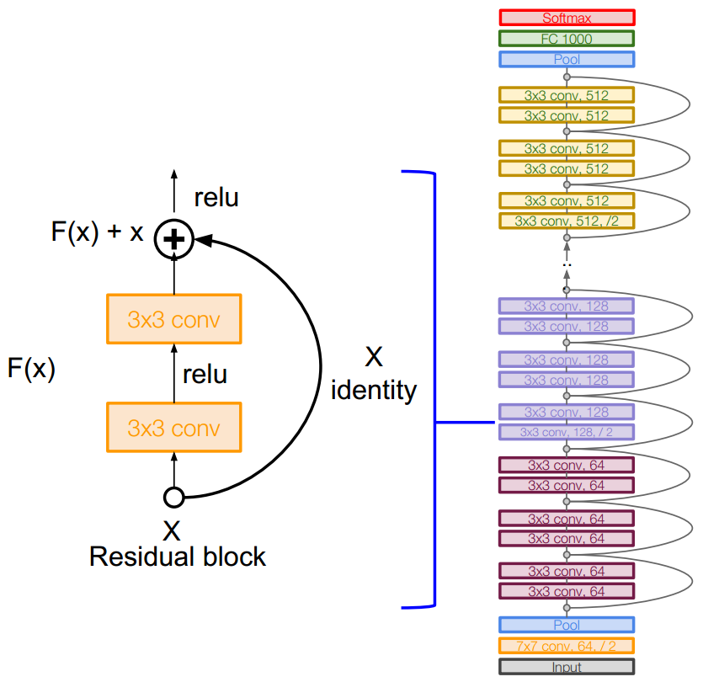

Slide 31
Xception (Extreme version of Inception)
Xception is an extension of the Inception architecture which replaces the standard Inception modules with depthwise separable convolutions.
The data first goes through the entry flow, then through the middle flow which is repeated eight times, and finally through the exit flow. Note that all Convolution and SeparableConvolution layers are followed by batch normalization.
XCeption is an efficient architecture that relies on two main points :
Depthwise Separable Convolution
Shortcuts between Convolution blocks as in ResNet

Slide 32
Depthwise Convolution
Depthwise Convolution is a first step in which instead of applying convolution of size d×d×C, we apply a convolution of size d×d×1. In other words, don’t make the convolution computation over all the channels, but only 1 by 1.
This creates a first volume that has size K×K×C , and not K×K×N as before. Indeed, so far, only made the convolution operation for 1 kernel /filter of the convolution, not for NN of them.

Slide 33
Pointwise Convolution
Pointwise convolution operates a classical convolution, with size 1×1×N1×1×N over the K×K×CK×K×C volume. This allows creating a volume of shape K×K×NK×K×N, as previously.

Slide 34
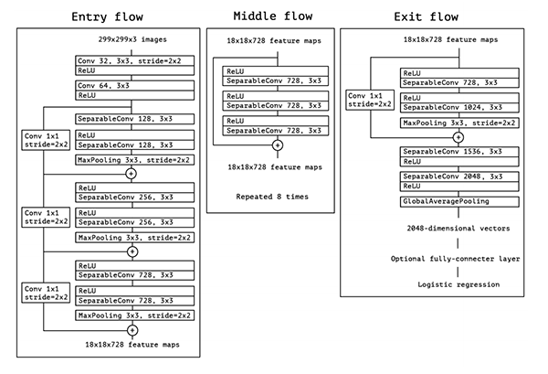
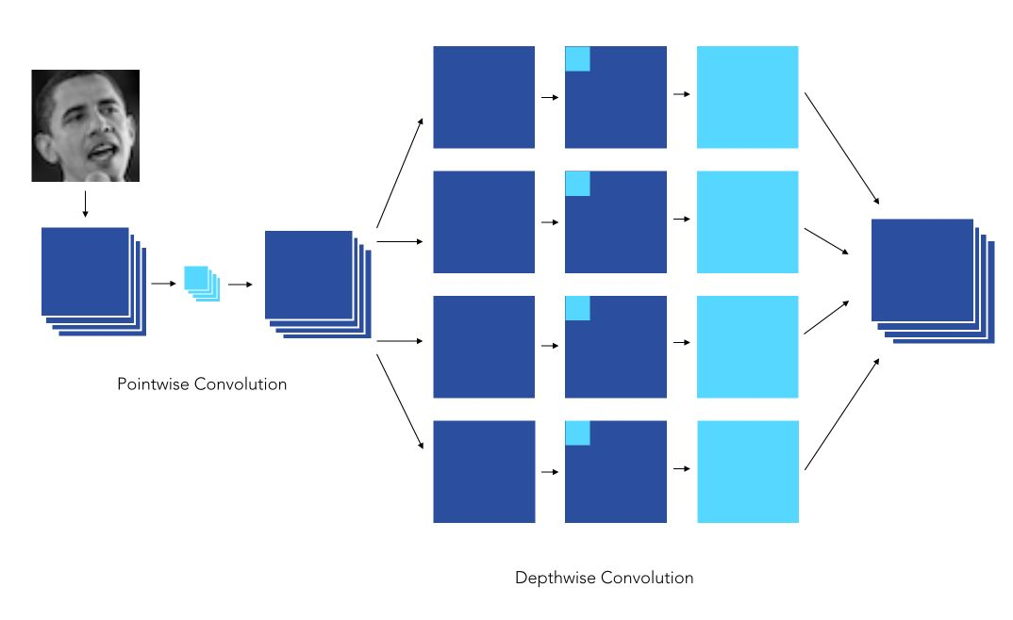

Slide 35
Architecture: Xception was 71 layers deep and had 23 million parameters. It was based on Inception-v3.
Year of Release: 2016
About: Xception was heavily inspired by Inception-v3, albeit it replaced convolutional blocks with depth-wise separable convolutions.
USP: Xception practically is a CNN based solely on depth-wise separable convolutional layers

